Slide 1
Digital Fortress
Crafting an Invincible Honeypot Network with Discord Alerts

Slide 2
Overview
The project "Digital Fortress: Crafting an Invincible Honeypot Network with Discord Alerts" enhances network security using a honeypot to attract and analyze cyber attackers. The honeypot was set up to appear vulnerable, particularly to SSH attacks, allowing for detailed monitoring using Wires hark. A Python script automated real-time alerts to a Discord channel, ensuring immediate response to any threats. The project demonstrated the value of honeypots in understanding attacker behavior and highlighted the importance of automation in cyber security. Firewall configurations further secured the network, leading to a more robust defense system. This approach offers valuable insights for future cyber defense strategies.

Slide 3
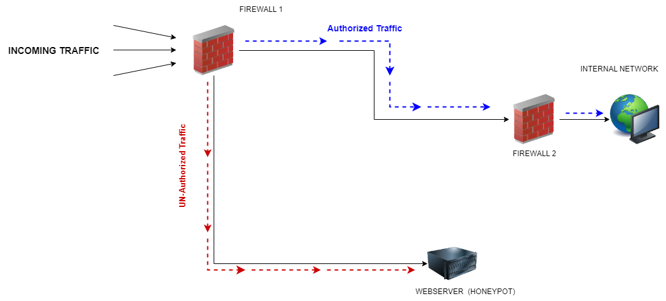
Digram

Slide 4
Tools and Setup
Setup and Tools
Network Setup: A honeypot was created within a network to simulate a vulnerable server, specifically targeting SSH attacks.
Tools Used:
Wire shark: Captured and analyzed network traffic, recording details of attacker interactions.
Python: Automated the process of sending real-time alerts to Discord based on Wire shark's data.
Discord: Served as the platform for receiving alerts through a webhook integration.
Firewall Fortigate VM: Configured to protect the network by managing and filtering traffic.
Automation: Python scripts were used to link Wireshark with Discord, ensuring immediate notification of any detected threats.

Slide 5
Setup
We placed a web server with vulnerability place between two fortigate VM firewall.
Authorized user from first firewall route to firewall two which is connected to internal network.
Unauthorized users will route to vulnerable web server.
On second firewall user will be get access through certificates file which we configure as legit certificates.
Vulnerable server send logs to discord. We automate this process by a python script using pyshark libraries.
Logs will be captured by wire shark.

Slide 6
Simulating Attack and Automation
To test the honeypot, simulated SSH attacks were launched, allowing the honeypot to capture the attacker's details, such as IP and MAC addresses. Wire shark monitored these interactions, and a Python script automated the process of sending real-time alerts to a Discord channel. This setup ensured that any suspicious activity was instantly reported, allowing for quick analysis and response.

Slide 7
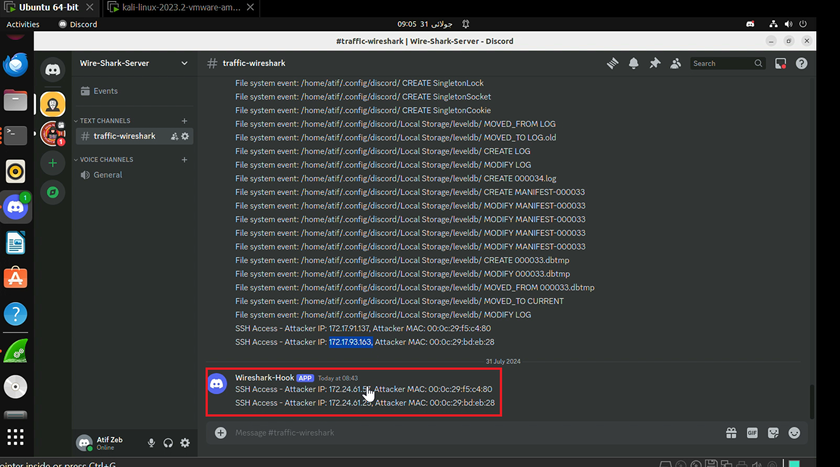
Discord Interface

Slide 8
Firewalls
Two FortiGate firewalls were deployed to protect the network. These firewalls filtered and controlled the traffic, allowing only authorized connections while directing any unauthorized or suspicious traffic to the honeypot. This setup helped in safely analyzing potential threats without risking the rest of the network, making the honeypot a key part of the network’s defense strategy.

Slide 9
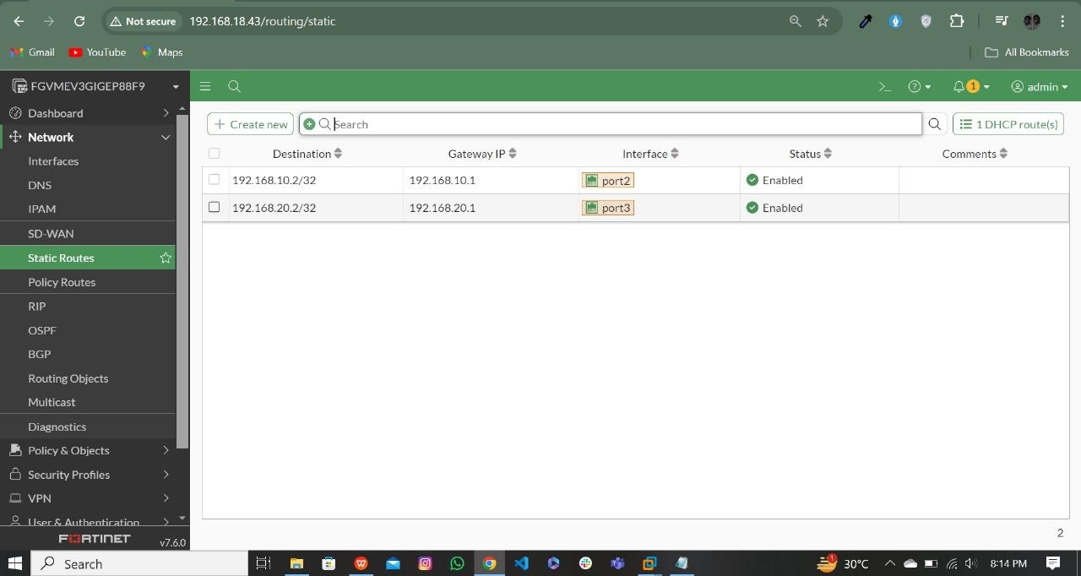
Firewalls Configured

Slide 10
Enhancing Security
To further strengthen network security, several measures were taken based on the data collected from the honeypot. The firewalls were fine-tuned to block known malicious IPs and restrict unauthorized access even more effectively. The honeypot's role was expanded to better detect and trap sophisticated attacks, and the automation scripts were improved to ensure quicker alerts and responses. These enhancements made the network more resilient against potential threats, reducing the risk of successful attacks and improving overall security.

Slide 11
Thank You
Created by
Atif Zeb

